Slide 1
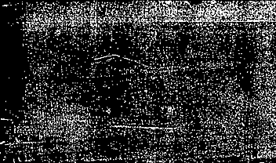

Handwritten Digit Recognition Using Deep Learning Models and Adversarial Attacks

Slide 2
Dataset: MNIST Handwritten Digits Dataset
Models Used:
Multi-Layer Perceptron (MLP)
Convolutional Neural Network (CNN)
Transformer Encoder
Adversarial Attacks:
Fast Gradient Sign Method (FGSM)
Projected Gradient Descent (PGD)
Momentum Iterative FGSM (MI-FGSM)

Slide 3
Dataset (MNIST)
The MNIST dataset contains 70,000 grayscale images of handwritten digits.
Training Images: 60,000
Testing Images: 10,000
Image Size: 28 × 28 pixels
Classes: Digits 0 through 9
The training set was used for learning, while the testing set was used as a final exam to evaluate model performance on images that were never seen during training.

Slide 4


Data Preprocessing
Before training the models, the images were preprocessed.
Each image consists of pixel values ranging from:
0 = Black
255 = White
To make learning easier for the neural network, all pixel values were normalized by dividing them by 255.
Example:
0 → 0.0
255 → 1.0
This scales all values between 0 and 1, helping the model learn faster and more efficiently.
The images were then converted into PyTorch tensors so they could be processed by the neural network models.

Slide 5
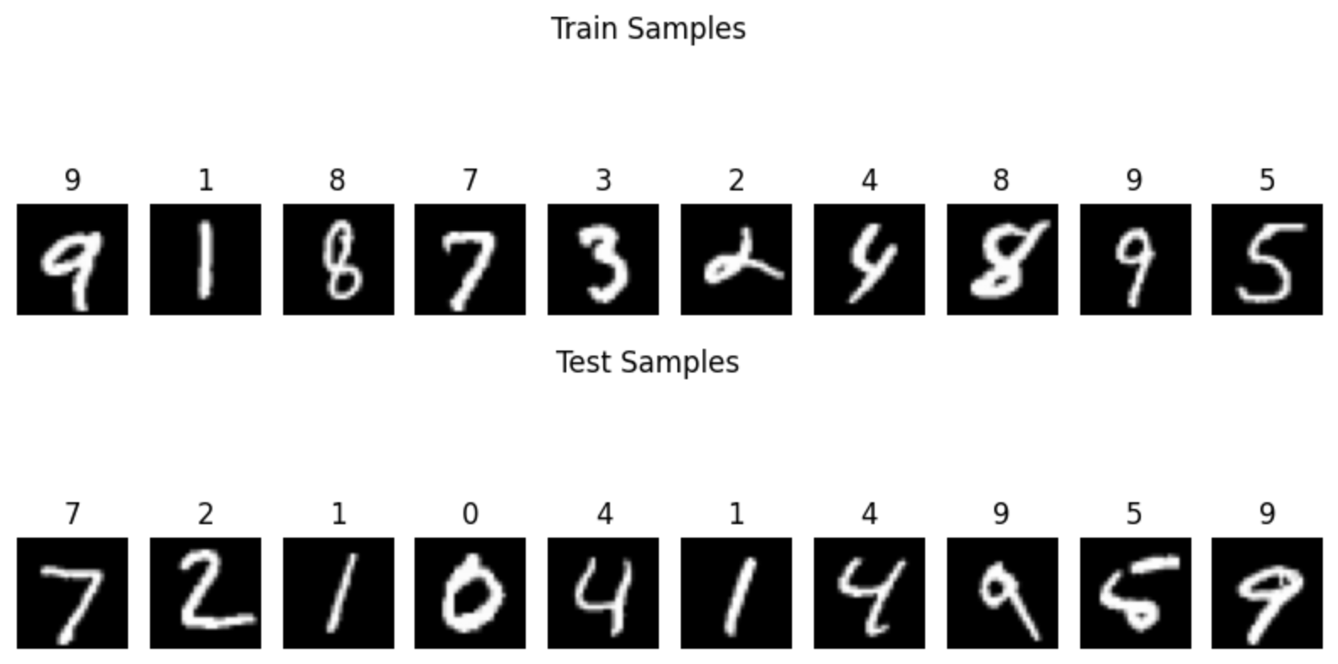
Data Augmentation
People write numbers in many different styles.
To help the models generalize better, data augmentation was applied.
The images were randomly:
Rotated slightly
Shifted slightly
This created many variations of the same digit and helped the model become more robust to handwriting differences.
Benefits of Data Augmentation:
Increases training diversity
Reduces overfitting
Improves generalization
Enhances real-world performance

Slide 6
Multi-Layer Perceptron (MLP)
The MLP learns mathematical relationships between pixel values.
After seeing thousands of examples, it learns patterns that frequently appear in each digit.
Horizontal line + Diagonal line = Likely a 7
The input image contains:
28 × 28 = 784 pixels
The MLP flattens the image into a vector of 784 numbers and processes them through fully connected layers.
Architecture:
Input Layer (784 neurons)
Hidden Layers
Output Layer (10 neurons)
Limitations:
Does not understand spatial relationships between pixels
Less effective for image recognition tasks

Slide 7
Convolutional Neural Network (CNN)
CNNs are specifically designed for image recognition tasks.
Instead of treating every pixel independently, CNNs learn visual patterns such as:
Edges, Lines, Corners, Curves, Shapes
The model gradually combines these features to recognize complete digits.
Example:
Two circles → 8
Circle + vertical line → 9
Advantages:
Learns image features automatically
Highly effective for image classification

Slide 8
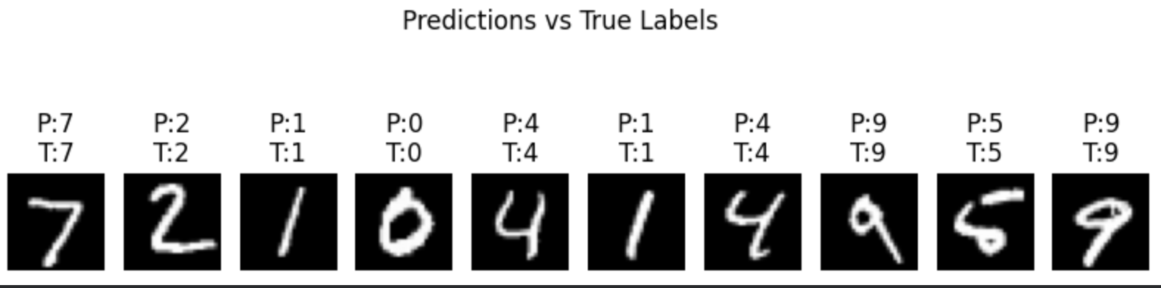
Training CNN Model...
Epoch 1: Loss=0.4098, Acc=97.83%
Epoch 2: Loss=0.1571, Acc=98.39%
Epoch 3: Loss=0.1226, Acc=98.73%
Epoch 4: Loss=0.1006, Acc=99.01%
Epoch 5: Loss=0.0907, Acc=99.00%

Slide 9

Transformer Encoder
Transformers are the same family of models used in modern AI systems such as ChatGPT.
The image is divided into small patches.
Each patch learns information about its local region and communicates with all other patches using a mechanism called Self-Attention.
This allows the model to understand relationships across the entire image.
Example:
One patch may see part of a loop while another patch sees the remaining loop. Together they determine that the image is likely an 8.
Advantages:
Captures global relationships
Powerful architecture
Widely used in modern AI research

Slide 10
Model Performance Comparison
Model | Accuracy
MLP | ~97%
Transformer | ~98%
CNN | ~99%

Slide 11
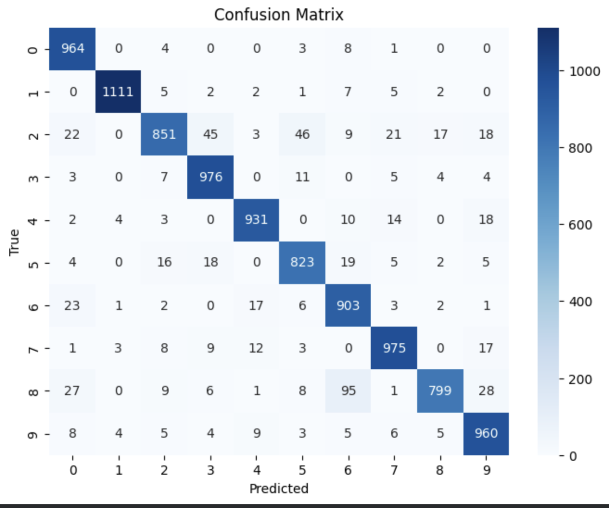
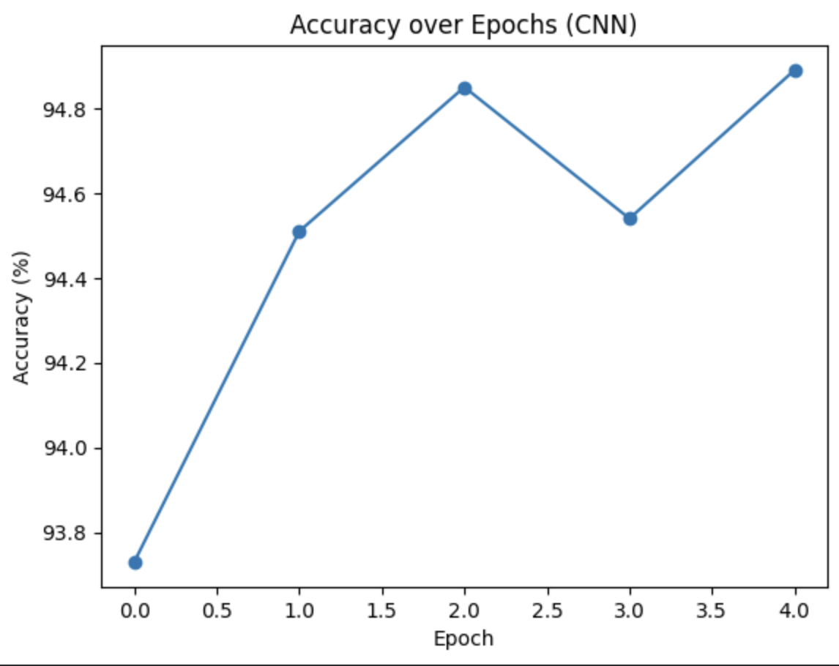
Accuracy over Epochs (CNN) confusion_matrix

Slide 12
Adversarial Attacks
Although deep learning models achieve high accuracy, they can be vulnerable to adversarial attacks.
An adversarial attack adds tiny perturbations to an image.
These changes are often invisible to humans but can completely change the model’s prediction.
Example:
Human sees: 7
Neural Network predicts: 1
This demonstrates a major security concern in deep learning systems.

Slide 13
FGSM Attack
FGSM stands for Fast Gradient Sign Method.
FGSM is a single-step adversarial attack.
The attack calculates which pixels are most important for the prediction and slightly modifies them in a direction that increases the model's error.
Attack Process:
Compute gradients.
Identify important pixels.
Add small perturbations.
Generate adversarial image.
FGSM is fast and computationally efficient.
Clean Accuracy: 98.91%
FGSM Accuracy: 13.73%
Attack Success Rate: 86.27%

Slide 14
PGD Attack
PGD stands for Projected Gradient Descent.
PGD is an iterative version of FGSM.
Instead of attacking once, PGD repeatedly modifies the image multiple times.
Attack Process:
Compute gradients.
Modify image slightly.
Recompute gradients.
Modify again.
Repeat for multiple iterations.
PGD is considered one of the strongest first-order adversarial attacks.
PGD Accuracy: 0.00%
Attack Success Rate: 100%
Interpretation:
The attack completely defeated the model.

Slide 15
MI-FGSM Attack
MI-FGSM stands for Momentum Iterative Fast Gradient Sign Method.
This attack combines:
FGSM
Iterative optimization
Momentum
Momentum helps the attack remember previous attack directions and accumulate stronger perturbations over time.
This makes the attack more stable and more effective.
Accuracy: 0.06%
Attack Success Rate: 99.94%
Interpretation:
The attack was nearly as effective as PGD.
Only 0.06% of images remained correctly classified.

Slide 16
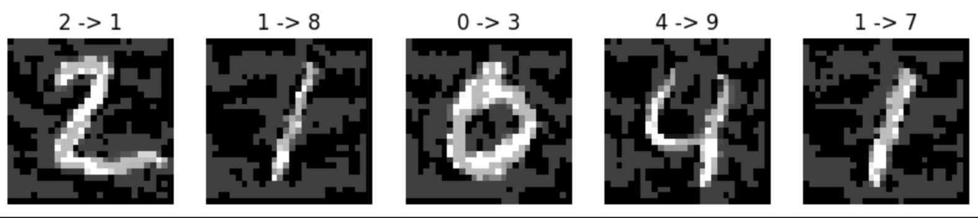
Attack Comparison
Scenario | Accuracy
Clean Images | 98.91%
FGSM | 13.73%
PGD | 0.00%
MI-FGSM | 0.06%

